Slide 1
Implementing Indigenous Subject Headings In Your Local Catalogue
From Planning to Process
Notes:
TAMMY - 9:05-9:08
Thank Karen.
Practical session on how to plan and implement Indigenous Subject Headings in your Local Catalogue.

Slide 2
Who We Are
Rachel Rogers, Coordinator, Collections and Technical Services
Greater Victoria Public Library
Tammy Moorse, Project Coordinator, Red Book Community Information
Hamilton Public Library
Notes:
TAMMY
Rachel and I have both worked in cataloguing roles in Technical Services departments at our respective libraries. And since proposing this session, have moved in to coordinator roles. While Rachel’s role has her leading technical services and cataloguing, mine has me still working with metadata, though in a very different schema, but I do still work with HPL’s technical services cataloguing team as the most experienced cataloguer on site at the central library.

Slide 3
Discussion Topics
Why Do It?
Getting Buy-In
What Terminology to Use
Workflows for Existing Collections
Working with New Material
Keeping Up-to-Date with Changes
Resources
Notes:
TAMMY
Our goal for presenting this session is to offer practical methods and ideas for those who are working in cataloguing, who want to make change, but who do not have a large team or a large amount of time to do this all at once.
I think it is safe to say that we hope that what we are going to take you through here, will be translatable to any initiative that involves changing subject headings to make them more inclusive, when you may not have access to the research and authorities that come with vendor records or OCLC records.
Why Do It
Getting Buy-in
What Terminology to Use
Workflows for Making Changes
Working with New Materials
Keeping Up-to-Date with Changes
How to move this forward - Nationally & Resources
Rachel and I will move through the following topics and leave time for questions at the end.
We will be coming at this from the perspective of our own library set ups, our ILS and PAC databases and how they interact, the features they offer to make changes to authorities and bibliographic records. And some of the other tools that we have access to.

Slide 4
WHY DO THIS?
Notes:
RACHEL 9:08-9:13
This is a quick overview, there are many discussions on this topic happening at other sessions at OLA.

Slide 5
Why do this?
Removing bias
Inclusivity
Reflect current terminology
Support local community
Notes:
RACHEL
Removing bias: subject headings can reinforce and perpetuate negative stereotypes. Changing headings can reflect positive changes in society and potentially put new terminology into more general use
Inclusivity: we want to make the library a welcoming space for all people; therefore don’t want to use terminology that makes people unwelcome; aim for inclusive and non-judgemental terminology
Reflect current terminology: using terminology in current use is better for users because it will lead to better search results - I’m sure we can all think of a time when we were surprised by the term that we ended up needing to search by to get the best results; also won’t make patrons uncomfortable that they have to search under outdated terminology
Finally, you can support your local community by making changes at the local level until change happens at the national/international level. Can see movement in US around “illegal aliens” - change was denied by US Congress, so many libraries are making those changes themselves (incl. GVPL)

Slide 6
Why do this?
Truth and Reconciliation
Indigenization, not decolonization
Led by Indigenous community
Notes:
TAMMY
Truth and Reconciliation: changing terminology in library catalogues is part of CFLA’s Truth and Reconciliation report; among other things, gives better naming to those who were named inaccurately and insensitively
Indigenization: Acknowledge that what we are doing is not decolonization, as we are settlers and cannot do this in a colonial system, we are indigenizing our catalogues to better represent this community with more appropriate language.
Led by Indigenous community: We are not getting leadership or guidance from Libraries and Archives Canada, but we have and continue to seek guidance from the Indigenous community - NIKLA and CFLA’s Indigenous Matters Committee as well as the decolonizing workshops that are being offered at and by various library conferences and professional organizations.

Slide 7
GETTING BUY-IN
Notes:
RACHEL 9:13-9:18
You’ve decided yes, you want to make changes! The next step is getting everyone else on board

Slide 8
What Management Needs to Know
Why is this good for your library?
How does this benefit your patrons?
How much time will it take initially?
How will it be maintained in the future?
Notes:
RACHEL
Why is this good for your library? How does it improve the library and the library experience?
How does this benefit your patrons? What kind of patron response should you expect?
How much time will it take to get the project going and edit all the records currently in your catalogue?
How will it be maintained in the future?

Slide 9
Preparing your proposal
Tie into Truth and Reconciliation work
Sell advantages to library
Sell advantages to library patrons
Cite other libraries doing similar work
Notes:
RACHEL
Can you tie this in to other work being done around Truth and Reconciliation at a library or municipal level? Project at GVPL approved in 2017 when Truth and Reconciliation was a top priority for the City of Victoria, one of the 10 municipalities served by GVPL.
Talk about how this can create good will for the library with indigenous communities in your area and with the public who access the catalogue. Especially important if you are inviting Indigenous authors or storytellers, or offering other Indigenous programming - you don’t want the catalogue to be out of step with what’s happening in the rest of the library
Talk about advantages to your library’s patrons - provides better access to information, puts less bias in front of patrons. Could frame it as responding to an unhappy patron, before the patron has a chance to be unhappy.
Ask around to libraries in your area or libraries comparable in size and see what work they’ve done. Lots of libraries in Canada have done or are working on this project right now, management will respond to that.

Slide 10
Preparing your project plan
How much pre-project work needed?
How many titles in catalogue will be affected?
How much time to make changes?
How much time is available?
Will this require additional/dedicated staff?
How will it be maintained going forward?
Notes:
RACHEL
Pre-project work: use already existing list or create your own; how much and what kind of consultation are you able to with Indigenous communities in your area?
How many titles: how many records, how many authorities
How much time needed: to test, could make change to one heading and associated records then extrapolate, always add extra time for the unexpected - will be talking about this in detail later on
How much time available: is there a deadline? Can this be added into regular workflow? Does other work need to be put aside?
Additional staff: Can it be done by staff on hand? Can there be project staff?
Maintenance: coming up later in presentation!

Slide 11
WHAT TERMINOLOGY
TO USE
Notes:
TAMMY 9:18-9:25
For those of us not members of Indigenous groups, and for me, who is trying to grow my knowledge from the very little I know, we need resources and the proper words to make these changes, particularly if we are doing this independently of the big authorities.
Lucky for us, there has been some great work done on terminology about Indigenous peoples BY Indigenous peoples.
Need to find GOOD resources with terminology about indigenous peoples BY indigenous peoples.

Slide 12
Figuring Out What to Use
Where do the big authority groups stand?
Considerations for choosing terms
Resources & Who is making change
Notes:
TAMMY
What LOC and LAC are offering currently.
Go through what to look for in a resource.
Review resources that are out there and other libraries making this change.

Slide 13
All Controlled Vocabularies
are LIVING documents
Notes:
TAMMY
Before I go in to this section. Please remember that….
They HAVE to change and adapt themselves over time.
And terminology can and will change quicker than the big guys - who move at a glacial pace, but keep your eyes on them.
You are here because this is something that needs doing NOW.

Slide 14
Where are the big authority groups stand?
Library of Congress
Libraries and Archives Canada
LOC does offer SH: INDIGENOUS PEOPLES as heading, can be subdivided & reflects Canadian terminology
Notes:
TAMMY
For Canadian libraries, the two considerations are the Library of Congress and Libraries and Archives Canada.
Canada as a whole prefers to use the term INDIGENOUS PEOPLES, which has changed from about 5-7 years ago when the preferred term was more ABORIGINAL PEOPLES. ABORIGINAL PEOPLES was not seen as encompassing Metis peoples.
Indigenous peoples encompasses First Nations, Metis and Inuit. INDIGENOUS PEOPLES is the preferred term of the United Nations Declaration on the Rights of Indigenous Peoples (UNDRIP).
Indigenous Peoples is a recognized Library of Congress Subject Heading that can be subdivided.
Libraries and Archives Canada - a good deal of frustration for non-OCLC libraries to find and use Canadian subject headings from LAC. VOILA doesn’t allow for subject heading only searching or access to scope notes for the authority subject headings.
Because LOC and LAC use Indigenous Peoples - Manitoba Archives opted to use this terminology to create their list mapping LOC to Indigenous Peoples.

Slide 15
Judging a Source:
Does the resource use inclusive terminology?
Is the resource developer an Indigenous group or has the resource developer consulted with indigenous groups?
Bring in Indigenous feedback to reflect local Indigenous communities to your area.
Ask - Reach out to Indigenous librarians… I have.
Notes:
TAMMY
Does your source have inclusive terminology? See what has been written about and the use of language and terms. Or have a base-line of what are good terms.
When looking at the resources available remember, some of these terms could be in flux - Decolonization has given way to Indigenization - as White folks as settlers and colonizers cannot decolonize as they are part of the colonial system. We can work to Indigenize - a recent change in terminology.
Has the source developed their terms in consultation with indigenous groups or ARE THEY an indigenous group? This is very important so that the terms reflect the community. We want to use the proper terminology to reflect the community and the indigenous group and their concepts - not guess or decide on terms that continue to reflect colonizer language.
Bannock vs. Fry Bread - Nuance of these terms I do not know. LC has Fry Bread - LAC - Bannock
Reach out to Indigenous Librarians - Asked about POW WOW music - Is this Dance Music? Came in coded in the 008 for Popular Music - Not happy with that classification for a decision in the 008 - FORM OF COMPOSITION - Dance Forms as this is considered dance music.

Slide 16
Resources:
MAIN - Manitoba Archival Information Network - chose Indigenous Peoples as their preferred term
NIKLA - National Indigenous Knowledge and Language Alliance - First Nations, Metis and Inuit Indigenous Ontology (FNMIIO) with CFLA
Greater Victoria Public Library’s LOC Subject Heading Mappings
List of URLs and such at the end - so they are all in one place.
Notes:
TAMMY
Key resources that are available:
MAIN - has done mapping from Indians of North America to Indigenous Peoples. Offered as a spreadsheet. It is based on their collection, so there are some gaps and if you have a collection that draws from American publishers - like we do, there are US Indigenous groups and terms that are not included.
NIKLA in partnership with the CFLA’s Indigenous Matters Committee released an Ontology in June of 2019. Great resource for Canadian Indigenous people and group names and languages.
GVPL based on MAIN and NIKLA and using consistency to represent groups south of the Canadian border.

Slide 17
LIBRARIES MAKING CHANGE LOCALLY:
Xwi7xwa Library at UBC (pronounced: whei-wha)
Greater Victoria Public Library
Hamilton Public Library
Toronto Public Library
Ryerson University
Nunavut Libraries - See the presentation by Carol Rigby
Notes:
TAMMY
Pronounced: Whei-wha
These libraries are in the process or have completed and are maintaining and monitoring terminology. All of their MARC records are available somewhere.
Speaking for HPL - you can see our full MARCs in MARC coding in our PAC - Bibliocommons under the FULL RECORD tab - down at the bottom.
BookWhere is a great resource, if you are a subscriber for getting MARC records and aren’t an OCLC member.

Slide 18
Copying the work
of others is OKAY.
Notes:
TAMMY
Use the work of other libraries… We are all running on limited time and resources. Where you can get help or down right take others work - DO IT.
Reference their MARCs. Give the librarians a call or drop them an email. And I do mean, feel free to contact me or a member of my cataloguing team.
If there is a ground-swell of libraries using this terminology locally, I hope we can influence LAC to change their terminology at some point in the future.

Slide 19
WORKFLOW FOR EXISTING COLLECTIONS
Notes:
RACHEL 9:25-9:30
Now we’re getting into the bulk of the work, making changes in your existing collections

Slide 20
Making THE Change
Add or Replace?
Updating Headings
Informing Staff
HPL Workflow
GVPL Workflow
Notes:
You’ve gotten your approval, made your project plan, chosen new terminology to use, and now it’s time to start working. In this section, we’re going to talk about:

Slide 21
Add or replace?
What kind of library and who are your patrons
Your catalogue or discovery layer
Many discovery layers don’t work with authority records, so may impact searching
Notes:
RACHEL
Add or replace refers to whether you're going to keep the original headings but add more appropriate headings, or whether you're going to remove the original headings entirely.
Important to think about your audience - an academic library might choose to leave original LCSH headings as faculty and students are used to using them, while adding more appropriate terminology. Special libraries or archives may want to build specialized vocabulary and replace entirely. Our opinion: public libraries should remove outdated terminology. Catalogue should reflect library values, including respect and inclusivity. As well, public libraries have a broad audience, one that you can’t easily reach to explain. (Go to next slide)
How does your ILS and PAC work for searching. How will the changes you make in your ILS reflect to patrons - what they see and what they can search by. For HPL, who use Bibliocommons, it will display our MARC records, where you can see how we have coded subject headings. Enterprise discovery layer used by GVPL - in progress adding custom tool that also searches authorities (not common in discovery layers) so searching non-preferred subjects
HPL and Ryerson have chosen to replace INDIANS OF NORTH AMERICA with the MAIN headings. Toronto Public Library chose to add MAIN headings, maintain INDIANS OF NORTH AMERICA and add a note about the terminology.

Slide 22
Toronto Public Library - MARC Note
594 $aToronto Public Library recognizes that the term “Indians” (used in subject headings such as “Indians of North America”) is offensive to many people. Although we currently maintain these headings to adhere to descriptive standards used by libraries worldwide, we and other Canadian libraries are working to replace them with ones that are acceptable to Indigenous Peoples in Canada.
Notes:
RACHEL
Toronto Public Library - is opting to currently keep Indians of North America and add additional subject headings. This will lead users to the new term Indigenous Peoples and but also provide Indians as an access point. They’ve added a local note to explain. (Go back to previous slide)

Slide 23
Updating headings
ILS tools
Export to tools like MarcEdit or OpenRefine
API
Make changes manually
Notes:
RACHEL
use tools within ILS (Polaris: can trigger change of heading by updating authority record; Symphony: can run Global Authority Change to change any non-prefered entries to preferred entry); editing capabilities for bib records; look at manuals or on ILS listservs to find hidden capabilities. Something to watch out for: many of these tools will change the heading, but you will want to change the second indicator as well, so that it no longer codes as LCSH. That might need to be done separately.
export to tool like MarcEdit for mass editing. If you are adding headings and you use BookWhere you could do it as a MACRO in MarcNotepad.
API tools - might require IT capacity for helping
manually change (depends on size of catalogue, but for some headings, this might be the fastest!). Depends how much clean up work you want to do - can take on faith that existing headings are accurate and use tools for mass conversion, or can review individual titles and update/upgrade headings (or maybe that’s a separate project)

Slide 24
Inform staff
Keep all staff working with MARC records up-to-date on changes
Make sure public services staff are aware of what is happening and why
Keep senior management in the loop
Document, document, document
Notes:
RACHEL
Let all staff interfacing with MARC records know about the changes that are happening in the catalogue.
Public services staff: give them talking points for answering questions from patrons
And document changes publically. Important to keep good documentation - as will be discussed later, cataloguing vendors and authority control vendors are willing to work with local headings, but need clear information

Slide 25
HPL Workflow:
ILS Authority Record Set - Authority Data based on search *Indian*
Remove terms that won’t be changed - Indiana, East Indians, any 110, 130 or 151 authorities from record set
Include Headings with Subdivisions: $vJuvenile literature or $vFiction
Plan the amount of time to do this and approximate finish date
Try the changes with 1 authority record
Notes:
TAMMY 9:30-9:40
We chose to find and replace the LOC headings. While INDIGENOUS PEOPLES is an approved term, we have made them local to better track them.
Polaris lets us to authority record sets - set on up using Indian - then removing terms that don’t fit.
Made sure to include headings with subdivisions
Had about 600 headings to change and link to each other - Polaris Authorities module doesn’t allow us to connect LOCAL headings to LC headings through the 008 and 550 fields. You can put in a 550 from a local to an LC but Polaris will not generate the actual link.
I do not currently have a finish date for my changes, due to some recent staffing issues. Ideally, I would like to have this completed by the end of 2020.
I have changed around 250 headings so far.

Slide 26
HPL Local Headings
HPL has implemented the following local heading:
650 #7 $aINDIGENOUS PEOPLE STORIES
Fits with other headings.
Notes for usage by HPL cataloguing staff include:
PREFER: CREE STORIES and INDIGENOUS PEOPLES STORIES
Notes:
TAMMY
I reached out to some of the Indigenous Librarians for information about the use of the terms FOLKLORE, MYTHOLOGY and LEGEND, when we received a title that included these SHs, but where they didn’t seem to fit with the story that was presented.
We talked about using the base term Oral Histories, but this LC term doesn’t capture those that are not about a personal experience. And MYTHOLOGY, while preferred by MAIN didn’t feel like the correct term either.
Created Indigenous peoples stories, based on a comment that they wish these stories could be documented like LC does for BIBLE STORIES, Buddhist Stories and Hindu Stories. (and there are others)

Slide 27
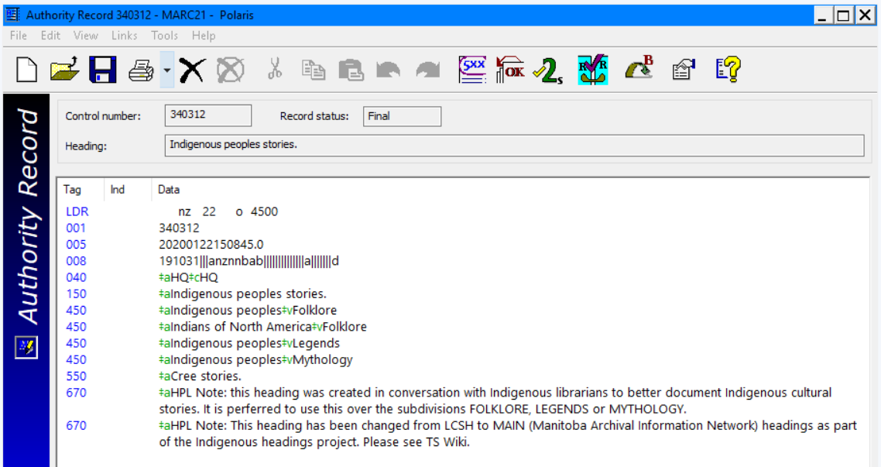
Example of Changed HPL Authority Record
Notes:
TAMMY
This is an example of one of our changed authority records. And this record, in particular contains 2 notes.
So you will see the first note is a local note on how to use this heading. Then there is the note that is included in all our changed headings.
In case you can’t read the second note:

Slide 28
HPL Workflow:
HPL ILS Authority Note:
670 ‡aHPL Note: This heading has been changed from LCSH to MAIN (Manitoba Archival Information Network) headings as part of the Indigenous headings project. Please see TS Wiki.
Notes:
TAMMY

Slide 29
HPL Workflow:
Edit Authority record
Cut and paste note
Change MARC authority fields in the original LOC headings
Authority module will update the new 1XX field on the MARC record’s SH
Keep change spreadsheet updated with deployed headings - on TS Wiki
Notes:
TAMMY
So we track all our changes on our internal cataloguing wiki on Sharepoint.
I edit an authority by changing the 150, changing the 150 to a 450, add in the note through cut and paste
When I save the record Polaris will prompt me about changing the headings in all the associated BIB records.
It will also point out where there are 550s that need changing in other authorities - I do those.
Then I add the mapping - previous heading and new heading to a spreadsheet and save this to our Tech Services Wiki

Slide 30
Notes:
TAMMY
Here is the first section of our documentation on this project for cataloguing staff to refer to.

Slide 31
Notes:
TAMMY
This is a shot of if you scroll further down the page.
I include the spreadsheet and all references to the other sources of information so that when we get new materials the cataloguing team can do their research for headings that haven’t been changed or that are new to our collections.
If there is a new term that needs to be tracked, I add it to the spreadsheet for quicker reference.

Slide 32
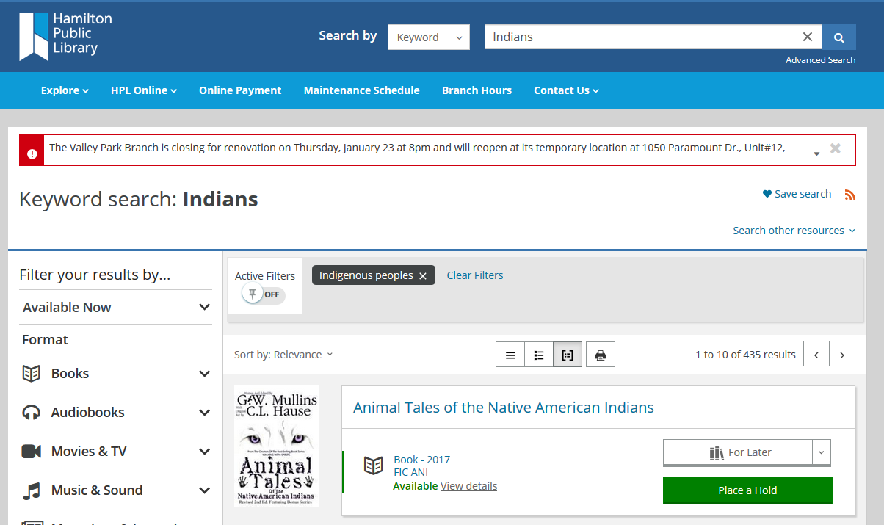
HPL’s PAC Display - Search: INDIANS
Notes:
From POLARIS these changes translate to our PAC - BIBLIOCOMMONS as follows:
Search for Indians will return results in the title or as a keyword in the record.
Sidebar - offers Indigenous peoples as a heading and filter…

Slide 33
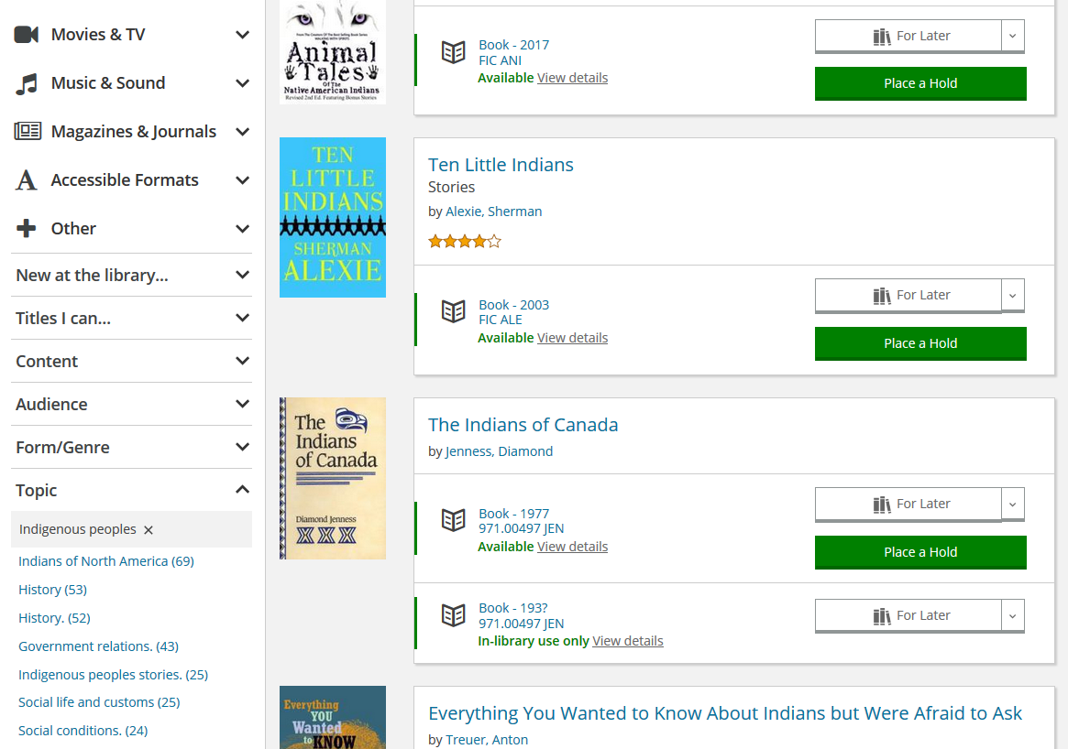
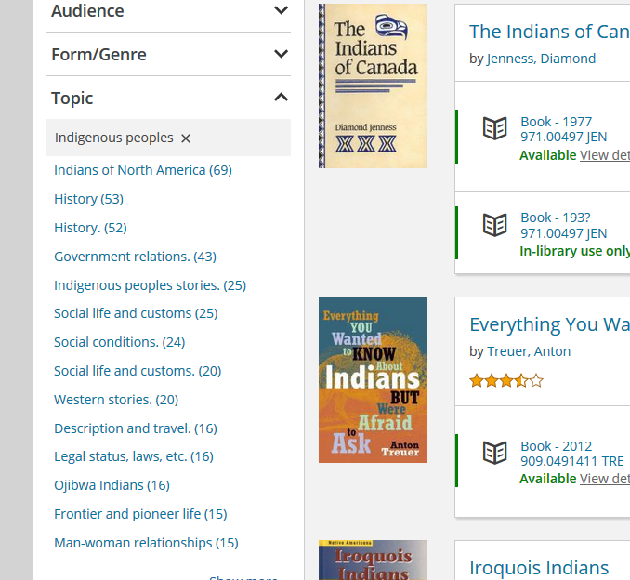
Notes:
You can see that there are still terms that have not been changed. BUT…
It shows Indigenous Peoples as a heading AND
It shows INDIGENOUS PEOPLES STORIES as an active and browsable term.

Slide 34
GVPL Headings
GVPL created set of subject headings based off work from Xwi7xwa Library, MAIN, NIKLA, independent research
New terms for all relevant LCSH and CSH headings
Using First Nations for peoples in Canada, Indigenous for peoples outside Canada plus First Nations, Métis, Inuit collectively
Use preferred names and remove “Indian” from name, i.e. Nootka Indians became Nuu-chah-nulth
Notes:
RACHEL 9:40-9:50
Link to GVPL headings in resources at end
Briefly, replaced "Indian” or “Indians” with "Indigenous" or "Indigenous peoples"
In Canada, use as collective term for First Nations, Inuit, and Métis
Also use for peoples from North and South America
Created headings for “First Nations” as a narrower term under “Indigenous”, on an equivalent level with “Inuit” and “Métis”, for works specifically relating to that group. Some of the “Indian” or “Indians” headings replaced with this
[Removed "…of North America", "…of Mexico", etc. from the main heading and replaced with geographical subdivisions. Use North America or Canada or province
Followed established rules in LC for geographic subdivisions – can end up with either Indigenous peoples—Civil rights—Canada or Indigenous peoples—Canada—Claims
In some cases, replaced subdivision with first level heading (Residential schools)
Replaced “mythology” with “religion”
Preferred Canadian terminology generally, for example “Band membership”
Removed “Indian” from names of Indigenous groups, for example “Haida” not “Haida Indians”
Used the preferred form of the names of Indigenous groups in Canada, as identified by the groups themselves or Indigenous reference sources, for example “Nuu-chah-nulth” instead of “Nootka”]

Slide 35
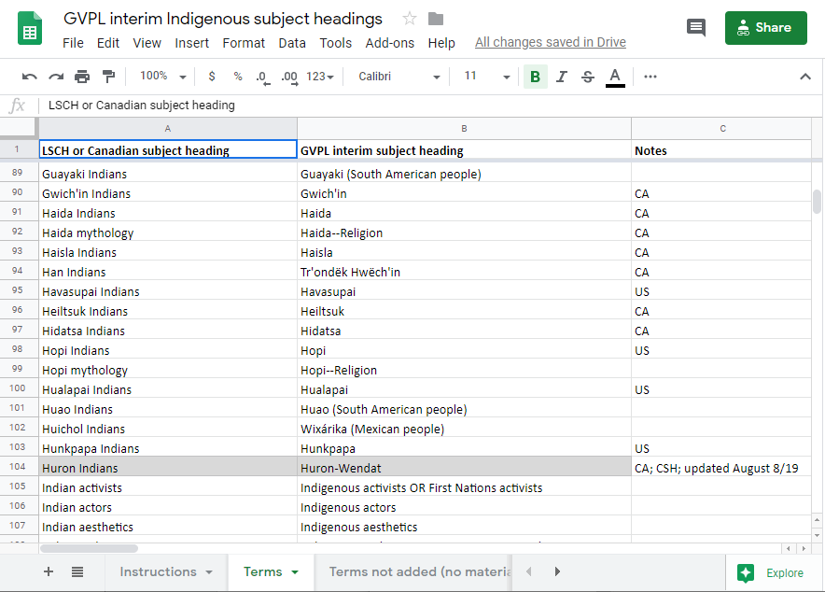
Notes:
RACHEL
Screenshot of our internal list for cataloguing staff use

Slide 36
GVPL workflow
Started by creating complete list of terms
Recommendation: start small!
Search each term in bibliographic database - terms not in catalogue went into separate tab for potential later use
Notes:
RACHEL
Because I was creating a new list of terms, I started by finding all terms in LCSH and CSH that needed to be changed, plus added additional terms from MAIN, Xwi7xwa and other lists. Divided into phases to track progress. Benefit was able to review terms when I came to them later
My recommendation is to start with a smaller term - I changed my mind multiple times at the beginning on how to make changes, what authority records to create, how to alter authority records
Start search in bib because our authority data not reliable - could do directly from authorities if you feel they’re up-to-date

Slide 37
GVPL workflow
Search for authority record
If authority record, edit as needed
If no authority record, import and edit or copy and create
Added additional 450 fields and 667 non-public notes/680 public notes as needed
Change bib either globally or manually
Must edit 2nd indicator
Update spreadsheet and staff page with changed terms
Notes:
RACHEL
Decided to edit LC/CSH authority records for speed - faster than creating full new authorities. Generally in our system only have authorities for first level (no subfields) but created authorities for “Indians of North America” etc at subfield levels, as well as for anything that needed more specificity
Changed globally for large terms, manually for smaller - wanted to review cataloguing wherever possible. Would probably use tools like MarcEdit more if starting again, but can’t always get good export results

Slide 38
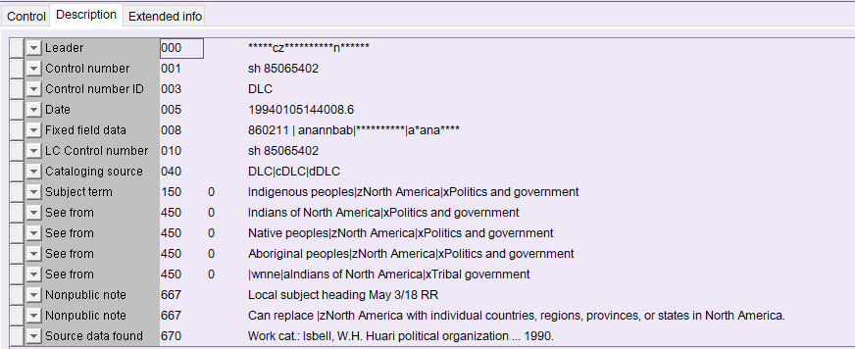
Example of GVPL edited authority record
Notes:
RACHEL

Slide 39
GVPL authority notes
667 Local subject heading May 3/18 RR
667 Can replace |zNorth America with individual countries, regions, provinces or states in North America
Notes:
RACHEL

Slide 40
WORKING WITH NEW MATERIAL
Notes:
RACHEL 9:50-9:55

Slide 41
Workflow for new materials
Doing in house:
Depends on size of library and size of department
Options:
Change at time of loading or importing records
Mass edits
Edit individually
What is available in your ILS?
Notes:
RACHEL
Depends on size of library - how many records are added daily/weekly, how many staff in the department, how much work is done in-house, who does the work at what level
Options: change at time of loading records using tools like MarcEdit, do mass edits after, check individually when copy cataloguing, other?
Look at tools or reports available in ILS that can help

Slide 42
Workflow for new materials
GVPL example:
Staff doing copy cataloguing refer to Excel document to find approved alternatives for obvious terms
Pass to Senior Cataloguer if questions or terms not found
Weekly report of unauthorized headings
Headings in files imported from vendors
Anything missed by staff
Works for medium sized library with senior cataloguing position
Notes:
RACHEL
Pull in record from OCLC. Technical Services Assistants and Library Assistants who do copy cataloguing refer to excel file to find approved alternatives for obvious terms needing updating, pass to Senior Cataloguer if there are questions or terms not found; Senior Cataloguer runs weekly report of unauthorized subject headings which catches headings in files imported from vendors plus anything missed by staff and manually change those. Not usually more than 10 headings in weekly report.

Slide 43
Workflow for new materials
Materials catalogued by library vendors
Can be done!
Ask about providing list of alternate headings
Some vendors have sets of alternate headings available
Authority control vendors
Can work with local authority headings
Can require careful creation of authorities and use in bibliographic records
Notes:
RACHEL
When we started project, many people who get shelf ready material from vendors felt they wouldn’t be able to make these changes. But this has become a big issue in Canada and many vendors have indicated willingness to work with client-defined list of alternative subject headings. Library Services Centre is launching a list of local Indigenous subject headings based on the GVPL list; Library Bound also using GVPL headings with libraries (Regina Public, Red Deer Public)
Most major authority control vendors (Backstage, MARCive) willing to work with local authorities, especially if authority records can be exported. Important to have good authority records and headings defined as local in the bib record.

Slide 44
KEEPING UP-TO-DATE
WITH CHANGES
Notes:
TAMMY 9:55-10:00
Follow organizations like NIKLA - National Indigenous Knowledge and Language Alliance (linked in resources at end) and the CFLA Indigenous Matters Committee. Participate in discussions on listservs and conferences and seminars. Share what you’ve done with your neighbouring libraries. Join the other sessions at OLA on Indigenizing your catalogue, especially the roundtable discussion on Friday from 9-10:30.
And this can be applied to other terminology. GVPL has changed Illegal Aliens to Undocumented Immigrants (plus all related headings).

Slide 45
Suggestions:
Twitter: follow those who are doing work in this area or in cataloguing - NIKLA, CFLA, librarians on twitter
On FB: Troublesome Catalogers and Magical Metadata Fairies
Conference and Unconferences
Listservs
OCATS: https://groups.google.com/d/forum/ontcats
Notes:
Social media - follow NIKLA, Indigenous matters committee, local Indigenous leaders or cultural leaders for discussions, active cataloguing librarians
Cataloguing Twitter - Is a thing. There are a lot of librarians active in this SM format.
FB - Troublesome Catalogers and Magical Metadata Fairies - they have been so helpful to me with questions
Conference sessions
Unconference session on TS and Cataloguing at 2 pm today
Listservs
OCATS - for those of you in Ontario, we have a small independent google group of 35 cataloguers and metadata workers but open to any one interested in cataloguing and metadata - https://groups.google.com/d/forum/ontcats - planning our first meeting in May at HPL - date TBD with planned webcast

Slide 46
RESOURCES
Notes:
RACHEL

Slide 47
GVPL (Greater Victoria Public Library) local indigenous headings: https://docs.google.com/spreadsheets/d/1qWWY5549qnS69_LpHEL7_XeiuyrX3onr58I4u3jrj5c/edit#gid=416984343
Xwi7xwa names for BC First Nations (updated Sept 2019): https://xwi7xwa-library-10nov2016.sites.olt.ubc.ca/files/2019/09/B.C.Names_.pdf
Indigenous Librarianship @ UBC resources:
http://guides.library.ubc.ca/c.php?g=307208&p=2049510
MAIN (Manitoba Archival Information Network) LCSH Subject Heading Mappings:
https://libguides.lib.umanitoba.ca/c.php?g=455567&p=3278374
NIKLA (National Indigenous Knowledge Management Alliance) Ontology:
https://nationalindigenousknowledgeandlanguagealliance.home.blog/2019/06/21/first-nations-metis-and-inuit-indigenous-ontologies-fnmiio/
Younging, Gregory. Elements of Indigenous Style : A Guide for Writing By and About Indigenous People. Brush Education, 2018.
Notes:
RACHEL

